Slide 1
TDD—Test Driven Development
Dhoot

Slide 2
The Bad Old Days
Back in the day developers would free-style.
Step-1: We, as in developers, would take imperfect specifications, scratch our heads and then knock out the code.
Step-2: We’d do some rudimentary testing:
If I buy a product, does it get reflected in my invoice?
If I change my address, is it reflected in my profile?
When I request my current P&L position on my trading book, is the profit/loss calculated correctly?

Slide 3
The Bad Old Days
Step-3: Once we had finished with our testing (and we were happy that we’d exhaustively tested the code), we would throw the code over the wall to the QC team.
Step-4: Of course the QC team would have spent time carefully crafting a range of test cases and high level integration tests.
Step-5: They would then run their test suites and produce copious amounts of bug reports that are then thrown over the wall back to the dev team to resolve.
Step-6: Devs would then fix the bugs→go to Step-2
Lets assume for a minute that this cycle worked in that the bugs were ironed out after just one pass.

Slide 4
The Bad Old Days
Lets also assume that we had fixed a major issue in sub-system A.
The fix changed code in a number of different functions and components.
However, unknown to you, your changes had an impact on some other system behaviour.
The QA team, after having developed some further test cases identify these behavioural failings and raise a number of bug reports for these .
It could easily be several months from the time you checked in your original fixes to sub-system A and the time these new bug reports land on your desk.
It is highly unlikely that you will remember the fixes you had developed all those months ago.

Slide 5
The Reformation
This is where Test Driven Development can provide you with a safety blanket.
Imagine the above scenario when TDD has been in place.
A bug report arrives on your desk.
You read through the report, set up your dev environment and immediately attempt to replicate the bug.
Assuming there is a bug this normally identifies that one or more classes lack sufficient unit tests—otherwise you would have found the bug when you ran your test suite.
This also highlights the fact that you for any non-trivial code base, you cannot hope to have 100% code coverage.

Slide 6
The Reformation
So, having established that there is a bug the first thing that you do is replicate the bug in your unit test code base.
When this new test is run it should fail—indicating clearly the presence of the bug.
We then have peace of mind—we know that we can start writing a code fix, and every once in a while we can run our unit tests and a press of a button.
This is empowering, because:
Not only do we know when we’ve fixed the outstanding bug (because the new unit test will pass)
But whenever we run the whole test suite we are also explicitly doing regression testing which means that we can be certain that no other existing code behaviour has been impacted by our code changes.

Slide 7
The Reformation
That’s incredibly powerful safety net to have.
In the Bad Old Days developers simply didn’t have this level of peace of mind.

Slide 8
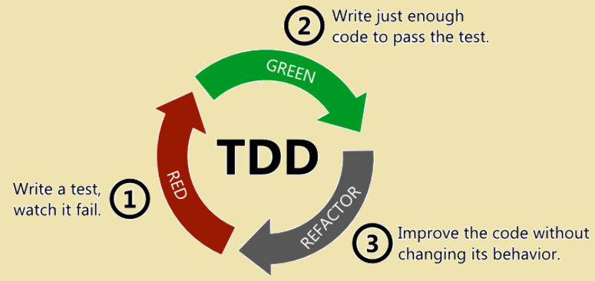
The TDD Process
The TDD process consists of a cycle

Slide 9
Terminology
What does unit mean in unit test? This is essentially a function, sometimes referred to as a unit of work. So, a unit test then is some code that will test the integrity of a unit of work/function.
System Under Test: This is what you’re testing in your unit test.

Slide 10
Some Worked Examples
We will try some worked examples:
2D Vector
Big Number Selector

Slide 11
TDD Tips
Your tests should be simple, clean and with as few lines of code as possible.
Recall, you want your tests to run as fast as possible—why would that be the case?
We want our tests to be simple to write—why?
Kent Beck advises to get a failing test from red to green as quickly as possible.
To do this, one approach is called Fake it till you make it. This is where a literal/constant is used that fakes the expected value back to the unit test to make the test pass. This also gives you re-assurance that the unit test works as expected.
But that’s crazy talk isn’t it? Well, it appears to be….however, the reason this is done is that it forces you to write more tests (at least you should). These extra tests in effect corroborate that the SUT is working.

Slide 12
TDD Tips
Kent Beck advises to get a failing test from red to green as quickly as possible.
Obvious implementation: this can work, but are you sure it is obvious? Do you have the tests in place to assert against your obvious belief? Clearly, the more experienced you are and the more run-of-the-mill the thing you are implementing, then the more attractive this option becomes. However, if the tests fail, or you become uncertain, or you

Slide 13
TDD Exercises
Complete the TwoDVector for operations such as scalar multiplication, subtraction and Magnitude. Magnitude is simply the distance from the zero vector, <0, 0> to the specified vector represented by a TwoDVector.
Write a calculator application according to the following specification given to you:
As a user I want to turn on the calculator and see the display showing 0 so that I know the calculator is ready for input.
Acceptance Tests
Input | Output
Nil | 0

Slide 14
TDD Exercises
As a user I want to input numeric values into the calculator with each digit appearing as each key is pressed so that I can see the digits being entered.
As a user I want to be able to select mathematical operators to apply to the numeric values I’ve entered so that I can do calculations.
Input | Output | Notes
1→2→5→9 | 1259 | Digits displayed in order
# | 0 | Clears what’s on screen
0→0→0→etc | 0 | This is an exception to the first test
+→+→ (or any multiple combo of operators) | Nil | Only the first operator is retained, except when a numeric value has been entered (here a negative key makes the value negative)
.→.→.→ | . | Only the first . Is processed, the others are ignored.

Slide 15
TDD Exercises
As a calculator I can only accept up to 8 numeric values of input so that overflow/underflow cannot occur.
Input | Output | Notes
0→1→2→3→4→5→6→7→8 | 12345678 | Digits displayed in order. Any subsequent digits are ignored.
1→2→3→4→5→6→7→8→9→0 | 12345678 | Digits displayed in order. Digits beyond the 8th one are ignored.
0→.→1→2→3→4→5→6→7→8 OR .→1→2→3→4→5→6→7→8 | 0.12345678 | Digits displayed in order. Second example the leading 0 is added by the calculator. Any subsequent digits are ignored.
+→+→ (or any multiple combo of operators) | Nil | Only the first operator is retained, except when a numeric value has been entered (here a negative key makes the value negative)
.→.→.→ | . | Only the first . is processed, the others are ignored.

Slide 16
TDD Exercises
As a calculator when the = key is pressed I will evaluate the expression entered so that I can display the results.
Note that when the = key is pressed, the calculator must be ready to accept new numeric input representing a new mathematical expression.
Input | Output | Notes
1→2→+→1→0→= | 22 | Calculated answer displayed
1→2→/→3→*→= | 4 | Calculated answer displayed—operators after the last operand are ignored.
1→= | 1 | The operand is simply displayed
= | 0 | Effectively a null operation.

